Slide 1
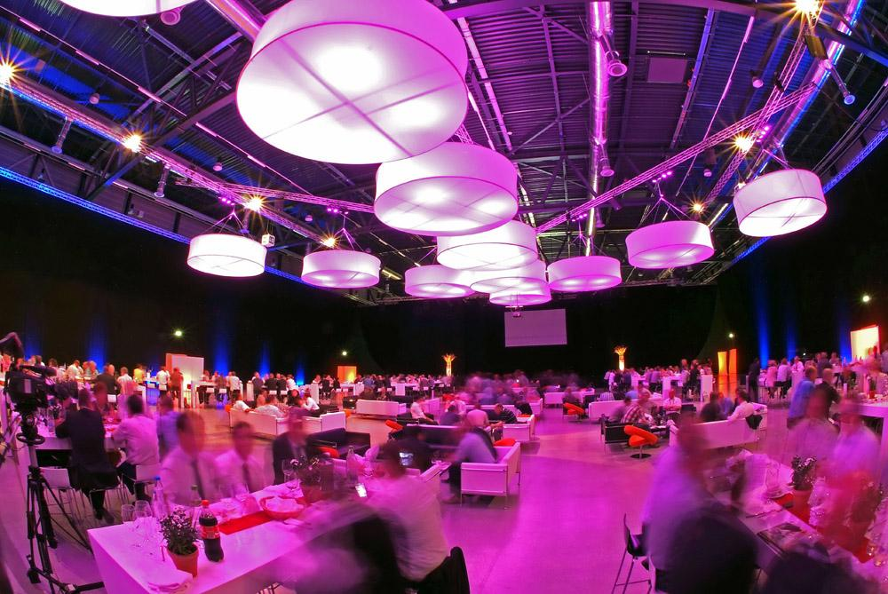

EVENT MANAGEMENT

Slide 2


TEAM MEMBERS:
AVINASH BHOJWANI (201IT211)
RADHIKA CHHABRA (201IT144)
SREENIVASAPUR ADNAN RAQEEB (201IT162)
VANSHIKA JOLLY (201IT263)

Slide 3
OVERVIEW:
Booking and managing events with all the essentials.

Slide 4


Modules
N ADMIN
CUSTOMER

Slide 5
ADMIN
CLASSES:
Dashboard
CustomerDetails
UpdateInventory
ViewDetails
Gateway
VenueGateway

Slide 6
WELCOME ADMIN !
CUSTOMER DETAILS
Credentials
Bookings
PaymentStatus
INVENTORY
View
AddNew
Alter
Delete

Slide 7




ADMIN
PAYMENT
CREDENTIALS
The admin can access to the registered customers credentials like username, email, phone number etc.
BOOKINGS
Admin can see all the bookings .
Admin can check the payment status of the booking order.

Slide 8
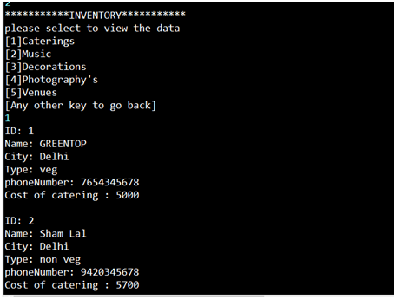
INVENTORY
View- Admin can see the various venues, caterings etc present in the inventory and respective details.
Add- Admin after viewing he can add new items in venue, caterings etc.
Alter- Admin can alter the existing data .
Example of view inventory
Delete- Admin can delete the existing data.

Slide 9
CUSTOMER
CLASSES:
Dashboard
Details
Input
Venue
Catering
Decoration
Music
Photography
Booking
Payment
Email
INTERFACE:
BookingInterface

Slide 10
WELCOME CUSTOMER!
NEW CUSTOMER ?
REGISTER
EXISTING CUSTOMER?
LOGIN

Slide 11
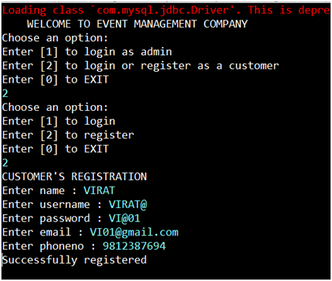
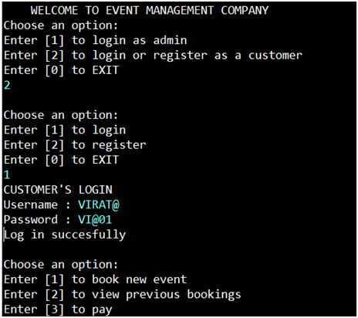
CUSTOMER REGISTRATION
CUSTOMER LOGIN

Slide 12

What all you need for an event?
Wait!
We have covered everything.

Slide 13
VENUE
CATERING
5-star
3-star
Moderate
Veg
Non-veg
DECORATION
Royal
Theme - based
Budget friendly

Slide 14
MUSIC
PHOTOGRAPHY
Dj/music
Music equipments
Delux
Med
Basic

Slide 15
SELECT YOUR CREDENTIALS
GET OPTIONS AS PER REQUIREMENTS
ENTER YOUR REQUIREMENTS
BOOK ONE YOU WANT.
CHECK DETAILS OF ALL OPTIONS.

Slide 16
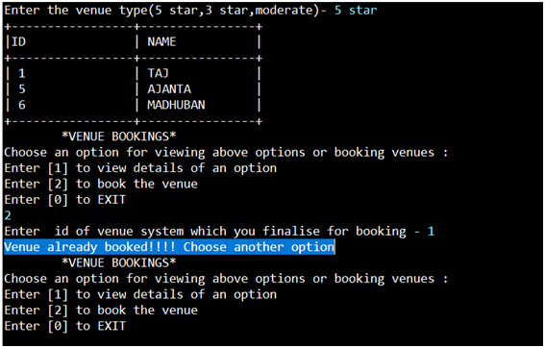
FEATURE
If your chosen option is already booked on your event date then you won’t able to book that . You have to choose some other options.

Slide 17
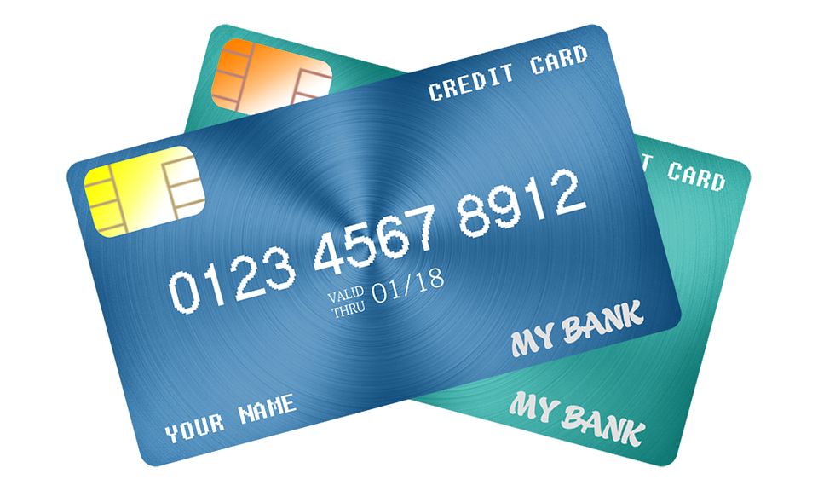

PAYMENT
Debit card
Google pay
Phonepe
Pay later

Slide 18
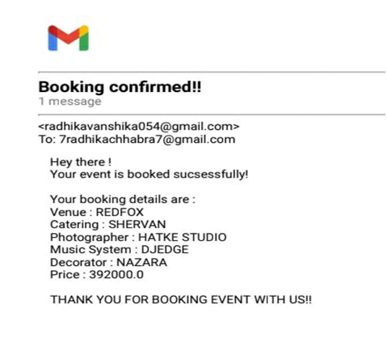
E-Mail

Slide 19
THANK YOU

